Slide 1


Better I/O Through
Byte-Addressable, Persistent Memory
Jeremy Condit, Ed Nightingale, Chris Frost,
Engin Ipek, Ben Lee, Doug Burger, Derrick Coetzee

Slide 2

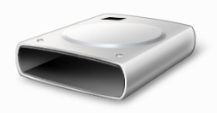
A New World of Storage
DRAM
+ Fast
+ Byte-addressable
- Volatile
Disk / Flash
+ Non-volatile
- Slow
- Block-addressable

Slide 3
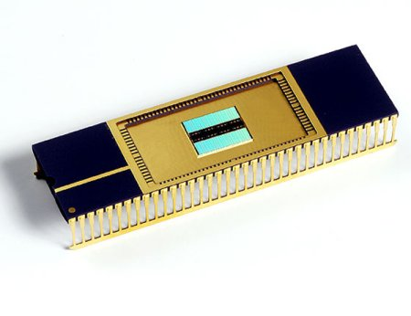
A New World of Storage
Byte-addressable, Persistent RAM
BPRAM
+ Fast
+ Byte-addressable
+ Non-volatile
How do we build fast, reliable systems with BPRAM?

Slide 4
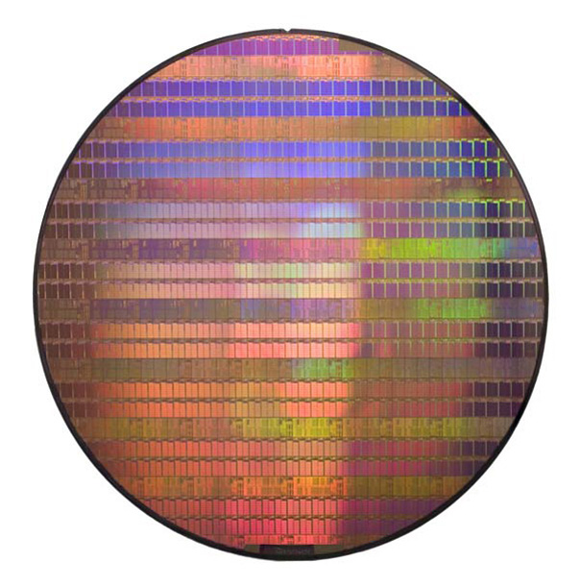
Phase Change Memory
Most promising form
of BPRAM
“Melting memory chips in mass production”
– Nature, 9/25/09

Slide 5
Phase Change Memory
phase change material
(chalcogenide)
slow cooling -> crystalline state (1)
fast cooling -> amorphous state (0)
Properties
Reads: 2-4x DRAM
Writes: 5-10x DRAM
Endurance: 10⁸+
electrode

Slide 6
A New World of Storage
Byte-addressable, Persistent RAM
BPRAM
+ Fast
+ Byte-addressable
+ Non-volatile
How do we build fast, reliable systems with BPRAM?
Disk / Flash
+ Non-volatile
- Slow
- Block-addressable
This talk: BPFS, a file system for BPRAM
Result: Improved performance and reliability

Slide 7
Goal
New guarantees for applications
File system operations will commit atomically and in program order
Your data is durable as soon as the cache is flushed
New mechanism:
short-circuit shadow paging

Slide 8
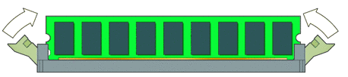
Design Principles
✗
1. Eliminate the DRAM buffer cache;
use the L1/L2 cache instead
2. Put BPRAM on the
memory bus
3. Provide atomicity and
ordering in hardware
Write A
Write B

Slide 9
Outline
Intro
File System
Hardware Support
Evaluation
Conclusion

Slide 10
BPRAM in the PC
BPRAM and DRAM are addressable by the CPU
Physical address space is partitioned
BPRAM data may be cached in L1/L2
L1
L2
Memory bus
DRAM
BPRAM
PCI/IDE bus
HD / Flash

Slide 11
BPFS: A BPRAM File System
Guarantees that all file operations execute atomically and in program order
Despite guarantees, significant performance improvements over NTFS on the same media
Short-circuit shadow paging often allows
atomic, in-place updates

Slide 12
BPFS: A BPRAM File System
root pointer
indirect blocks
inode
file
inodes
file
directory
file

Slide 13
Enforcing FS Consistency Guarantees
What happens if we crash during an update?
  Disk: Use journaling or shadow paging
  BPRAM: Use short-circuit shadow paging

Slide 14
Review 1: Journaling
Write to journal, then write to file system
file system
A
A’
B
B’
journal
A’
B’
Reliable, but all data is written twice

Slide 15
Review 2: Shadow Paging
Use copy-on-write up to root of file system
file’s root pointer
A
B
A’
B’
Any change requires bubbling to the FS root
Small writes require large copying overhead

Slide 16
Short-Circuit Shadow Paging
Inspired by shadow paging
  Optimization: In-place update when possible

Slide 17
Short-Circuit Shadow Paging
Inspired by shadow paging
  Optimization: In-place update when possible
file’s root pointer
A
B
A’
B’
Uses byte-addressability and atomic 64b writes

Slide 18
Opt. 1: In-Place Writes
Aligned 64-bit writes are performed in place
  Data and metadata
file’s root pointer
in-place write

Slide 19
Opt. 2: Exploit Data-Metadata Invariants
Appends committed by updating file size
file’s root pointer + size
file size update
in-place append

Slide 20
BPFS Example
root pointer
indirect blocks
inode
file
inodes
add entry
remove entry
directory
directory
file
Cross-directory rename bubbles to common ancestor

Slide 21
Outline
Intro
File System
Hardware Support
Evaluation
Conclusion

Slide 22
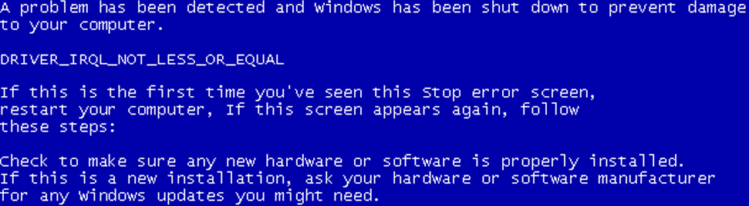
Problem 1: Ordering
L1 / L2
...
CoW
Commit
...
BPRAM

Slide 23
Problem 2: Atomicity
L1 / L2
...
CoW
Commit
...
BPRAM

Slide 24
Enforcing Ordering and Atomicity
Ordering
  Solution: Epoch barriers to declare constraints
  Faster than write-through
  Important hardware primitive (cf. SCSI TCQ)
Atomicity
  Solution: Capacitor on DIMM
  Simple and cheap!

Slide 25
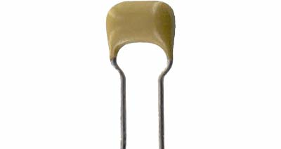
Ordering and Atomicity
Ineligible for eviction!
L1 / L2
2
...
CoW
Barrier
Commit
...
1
1
1
BPRAM
MP works too
(see paper)

Slide 26
Outline
Intro
File System
Hardware Support
Evaluation
Conclusion

Slide 27
Methodology
Built and evaluated BPFS in Windows
Three parts:
  Experimental: BPFS vs. NTFS on DRAM
  Simulation: Epoch barrier evaluation
  Analytical: BPFS on PCM

Slide 28
Microbenchmarks
NOT DURABLE!
NOT DURABLE!
DURABLE!
NTFS - Disk
NTFS - RAM
BPFS - RAM
DURABLE!

Slide 29
BPFS Throughput On PCM
BPFS - PCM
Projected
Throughput
NTFS
Disk
NTFS
RAM
BPFS
RAM
BPFS
PCM
(Proj)
Sustained Throughput of PCM (MB/s)

Slide 30
Conclusions
BPRAM changes the trade-offs for storage
  Use consistency technique designed for medium
Short-circuit shadow paging:
  improves performance
  improves reliability
Bonus: PCM chips on display at poster session!

